Slide 1
Deep Learning
Fundamentals Keras and TensorFlow
Building a binary classifier in Keras
Marya Butt, PhD.
Researcher Data Driven Smart Society (DDSS)
BIG DATA, Computer Vision, Cloud Computing
Faculty of Engineering Design and Computing
Mob: +31(0) 0611878759
E: marya.butt@Inholland.nl

Slide 2



Agenda (Today)
Keras/tensorflow
Full example Walkthrough
Practice

Slide 3
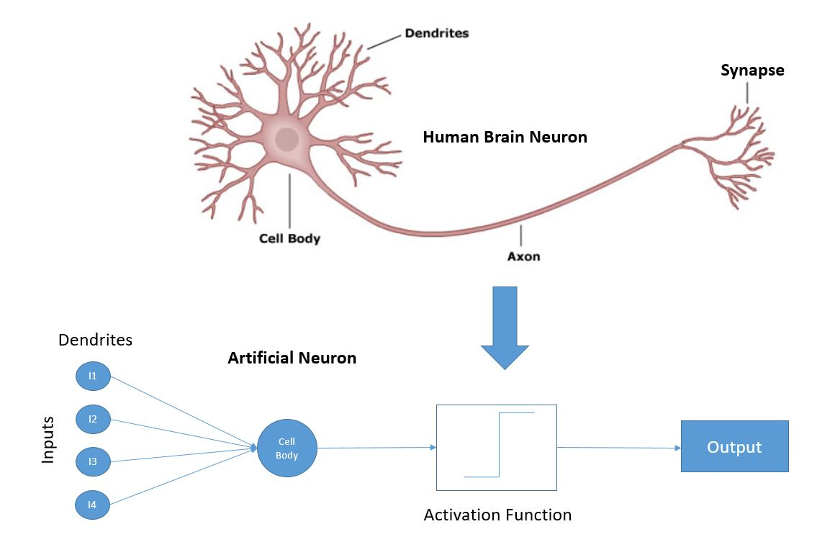
Neuron & Artificial Neuron

Slide 4
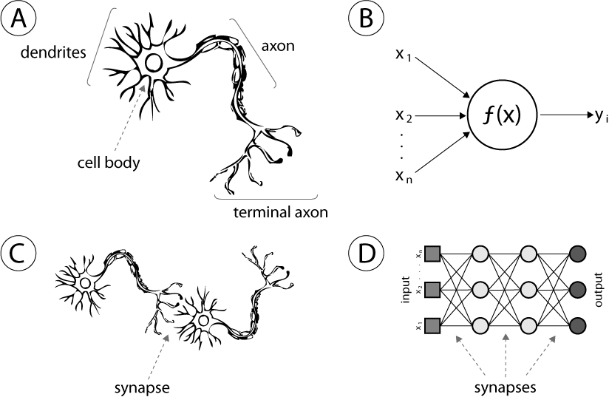
Neuron Connectivity for Problem Solving
Source: http://www.intechopen.com/source/html/39067/media/image1.png

Slide 5
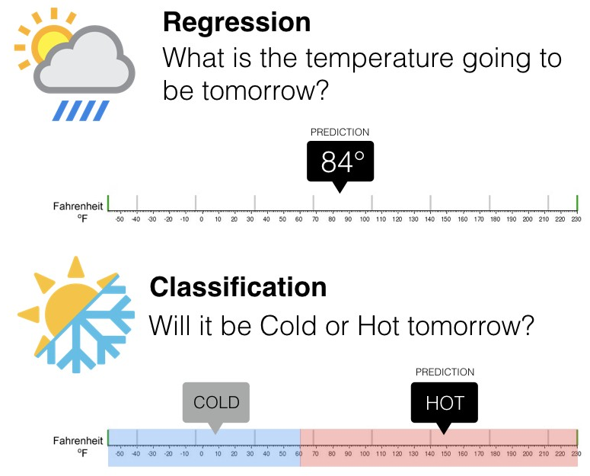
Types of problems in Machine Learning

Slide 6
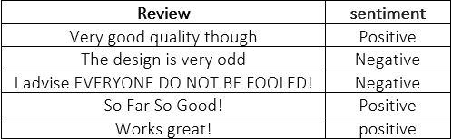
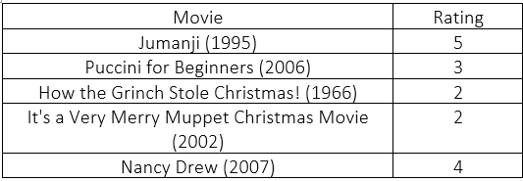
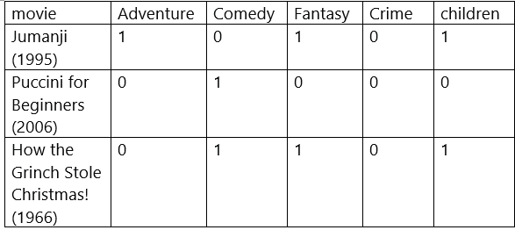
Classification
Binary Classification
In binary classification problem, any of the samples from the dataset takes only one label out of two classes. example, Let’s see an example of small data taken from amazon reviews data
MultiClass Classification
For a given dataset, any of the samples that come from the dataset takes only one label out of the number of classes.
example: movies reviews dataset
MultiLabel Classification
Each input can have multiple or none of the designated output classes. Let’s see an example of small data from the movie’s Genre dataset.

Slide 7
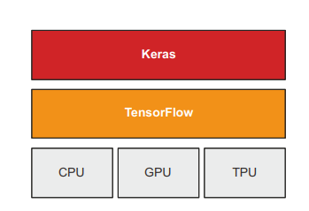
TensorFlow and Keras
TensorFlow
TensorFlow is a Python-based, free, open source machine learning platform
Developed primarily by Google
Like NumPy, the primary purpose of TensorFlow is to enable engineers and researchers to manipulate mathematical expressions over numerical tensors, but TensorFlow goes far beyond the scope of NumPy
Keras
Keras is a deep learning API for Python
Built on top of TensorFlow
Provides a convenient way to define and train any kind of deep learning model
Keras was initially developed for research, with the aim of enabling fast deep learning experimentation
Through TensorFlow, Keras can run on top of different types of hardware

Slide 8
TensorFlow vs Keras
Building a model with TensorFlow requires a strong understanding of every transformation/calculation occurring throughout the model.
Keras is, on the other hand, is a high-level wrapper library. It abstracts away much of the complexity that comes with TensorFlow itself.
Keras speeds up development time significantly. However, since TF2, both Keras and TensorFlow are imported with install tensorflow as tf
Note: many people say ‘TensorFlow’ when referring to Keras, both are used interchangeably

Slide 9
Setting up a Deep Learning workspace (Different possibilities)
Jupyter notebooks
The preferred way to run deep learning experiments
A notebook is a file generated by the Jupyter Notebook app (https://jupyter.org) that you can edit in your browser.
Using Colaboratory
To get started with Colab, go to https://colab.research.google.com
Installing packages with pip
if there is a need to install something with pip, can be done by using the following syntax in a code cell (note that the line starts with ! to indicate that it is a shell command rather than Python code):
!pip install package_name

Slide 10
Setting up a Deep Learning workspace (Different possibilities)
Jupyter notebooks
The preferred way to run deep learning experiments
A notebook is a file generated by the Jupyter Notebook app (https://jupyter.org) that you can edit in your browser.
Using Colaboratory
To get started with Colab, go to https://colab.research.google.com
Installing packages with pip
if there is a need to install something with pip, can be done by using the following syntax in a code cell (note that the line starts with ! to indicate that it is a shell command rather than Python code
!pip install package_name

Slide 11
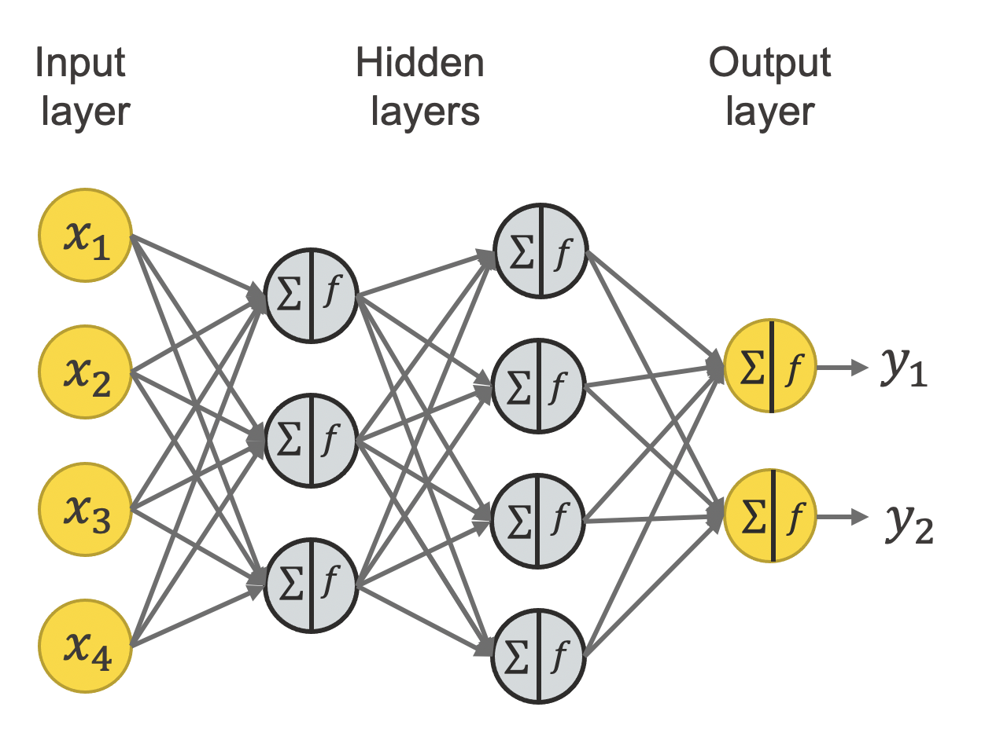
What is building a neural network model?
Using Numpy library (without Keras and TF
Using tensorflow and keras libraries

Slide 12
A simple Example!
i/p
o/p
{Model performance= difference}
b
BP | Age
72 | 50
80 | 51
64 | 66
88 | 44
model
BP * w
Predicted Age=Activation(BP * w +b)
w= Weight
b= Bias
Lets design a single layer neral network in Keras!

Slide 13
Using Keras to Develop a Neural Network
Design the network
(Sequential vs Functional)
Number of neurons
Number of layers
Compile Model
Loss
Optimizer
Metrics
Import Libraries
Make Predictions
Fit the model
Provide x and y
Epochs
Batch_size
Plot Learning curves

Slide 14
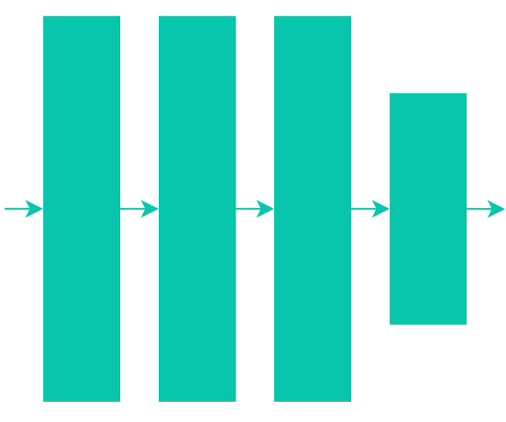
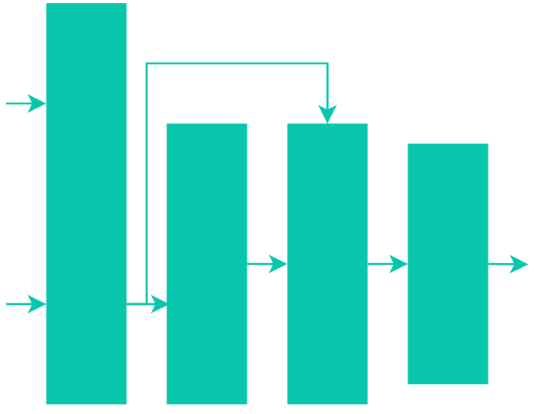
Using Keras to Develop a Neural Network
Model Building Approaches in Keras
Sequential model is used for simple, sequential stacks of layers where each layer has one input and one output
Functional API is used for architectures that require more than a single input/output in any layer

Slide 15
Using Keras to Develop a Neural Network
Model Building Approaches in Keras
Sequential is easy and fast Functional API is flexible than its Sequential counterpart. Functional API is used when:
Information flow through the model is non-linear (i.e., not sequential).
Layers need multiple inputs and/or outputs.
The model uses multiple inputs and/or outputs.
Keep in mind that you can still use the functional API for sequential models — nothing is stopping you from doing so, but it may be cleaner to use the sequential approach

Slide 16

Using Keras to Develop a Neural Network
If we want to predict age based on the Blood Pressure using a single layer neuron, which building approach is better to be used?
model
BP
Age
BP * w +b
Sequential Approach is a better option

Slide 17
Using Keras to Develop a Neural Network
1. Import Sequential and Dense Classes from models and layers library of Keras respectively
from keras.models import Sequential
from keras.layers import Dense
2. Sequential class allows to build a model of type sequential
model=Sequential()
.
model
BP
Age
BP * w +b

Slide 18
Dense implements the operation:
output = activation(dot(input, kernel) + bias)
activation is the element-wise activation function passed as the activation argument,
kernel is a weights matrix created by the layer
Using Keras to Develop a Neural Network
3. Add a Dense layer (used for fully connected NN)
model.add(Dense(1, input_dim=1, activation=‘linear’))
units: Positive integer, dimensionality of the output space.
activation: Activation function to use. If you don't specify anything, no activation is applied (i.e. "linear" activation: a(x) = x).
use_bias: Boolean, whether the layer uses a bias vector.
kernel_initializer: Initializer for the kernel weights matrix.
bias_initializer: Initializer for the bias vector.
kernel_regularizer: Regularizer function applied to the kernel weights matrix.
bias_regularizer: Regularizer function applied to the bias vector.
activity_regularizer: Regularizer function applied to the output of the layer (its "activation").
kernel_constraint: Constraint function applied to the kernel weights matrix.
bias_constraint: Constraint function applied to the bias vector.

Slide 19
Using Keras to Develop a Neural Network
3. Add a Dense layer (used for fully connected NN)
model.add(Dense(1, input_dim=1, activation=‘linear’))
Dense(
units,
activation=None,
use_bias=True,
kernel_initializer="glorot_uniform",
bias_initializer="zeros",
kernel_regularizer=None,
bias_regularizer=None,
activity_regularizer=None,
kernel_constraint=None,
bias_constraint=None,
)
Read more: Dense layer (keras.io)

Slide 20
Using Keras to Develop a Neural Network
4. Compile the model
model.compile (loss=‘mse’ , optimizer = ‘rmsprop’ , metrics=[‘mae’])
Loss: function that is used to compute the error is known as Loss Function
Optimizer: function used to modify/update weights (rmsprop/Adam/nadam/SGD)
Metrics: function that is used to judge the performance of the model
Note: Metric functions are similar to loss functions, metrics are used to monitor the performance of the model beyond the loss function. Note that you may use any loss function as a metric or even define your own custom metric functions.

Slide 21
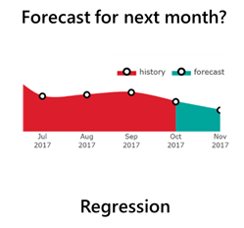

Using Keras to Develop a Neural Network
4. Compile the model
How to choose the loss function?
Regression Loss Functions
Mean Squared Error Loss (mse)
Mean Squared Logarithmic Error Loss (msle)
Mean Absolute Error Loss (mae)
Binary Classification Loss Functions
Binary Cross-Entropy
Hinge Loss
Squared Hinge Loss
Multi-Class Classification Loss Functions
Multi-Class Cross-Entropy Loss
Sparse Multiclass Cross-Entropy Loss
Kullback Leibler Divergence Loss

Slide 22

Using Keras to Develop a Neural Network
4. Compile the model
How to choose the optimizer?
Optimizers are used to update weights and biases i.e., the internal parameters of a model to reduce the error. There are 2 categories of optimizers.
Adaptive Learning algorithms
Non-adaptive learning algorithms
Stochastic Gradient Descent falls
under this category
Adam
Adagrad (sparse dataset)
Adadelta
RMSprop
hyperparameters
η = learning rate
m= momentum (determines the velocity with which learning rate has to be increased to approach the minima)
Read More: Loss Functions and Optimization Algorithms. Demystified. | by Apoorva Agrawal | Data Science Group, IITR | Medium

Slide 23
Using Keras to Develop a Neural Network
4. Compile the model
How to choose the optimizer?
Optimizers are used to update weights and biases i.e., the internal parameters of a model to reduce the error. There are 2 categories of optimizers.
Adaptive Learning algorithms
Non-adaptive learning algorithms
doesn’t need to set learning rate, just need to initialize the learning rate parameters 0.001 and these adaptive optimization algorithms keep updating learning rates while training the model.
need to set a hyperparameter learning rate before training the model. If this learning rate doesn’t give good results, we need to change the learning rates and train the model again

Slide 24
Using Keras to Develop a Neural Network
4. Compile the model
Choice of the optimizer
Stochastic Gradient Decent is much faster than the other algorithms but the results produced are far from optimum. Both, Adagrad and Adam produce better results that SGD, but they are computationally extensive. Adam is slightly faster than Adagrad. Thus, while using a particular optimization function, one has to make a trade off between more computation power and more optimum results.
loss=‘mse’ , optimizer = ‘rmsprop’ , metrics=[‘mae’])
Read More: Loss Functions and Optimization Algorithms. Demystified. | by Apoorva Agrawal | Data Science Group, IITR | Medium

Slide 25
Using Keras to Develop a Neural Network
5. fit the model
X= dataset.iloc[:,0]
Y= dataset.iloc[:,1]
model.fit (X, Y, epochs= 2000, batch_size=32, verbose=1)
X= input variables
Y= output variable
Epochs=no of times, the model sees the entire dataset
Batch_size= in one epoch, number of training examples utilized
All rows, first column
All rows, second column
BP | Age
72 | 50
80 | 51
64 | 66
88 | 44

Slide 26
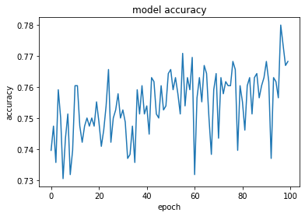
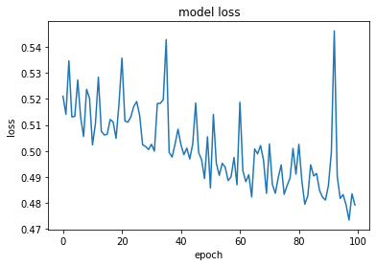
Using Keras to Develop a Neural Network
6. Calculate the accuracy
7. Plot learning curves

Slide 27
What is different, if the Functional approach is used to build a NN?

Slide 28
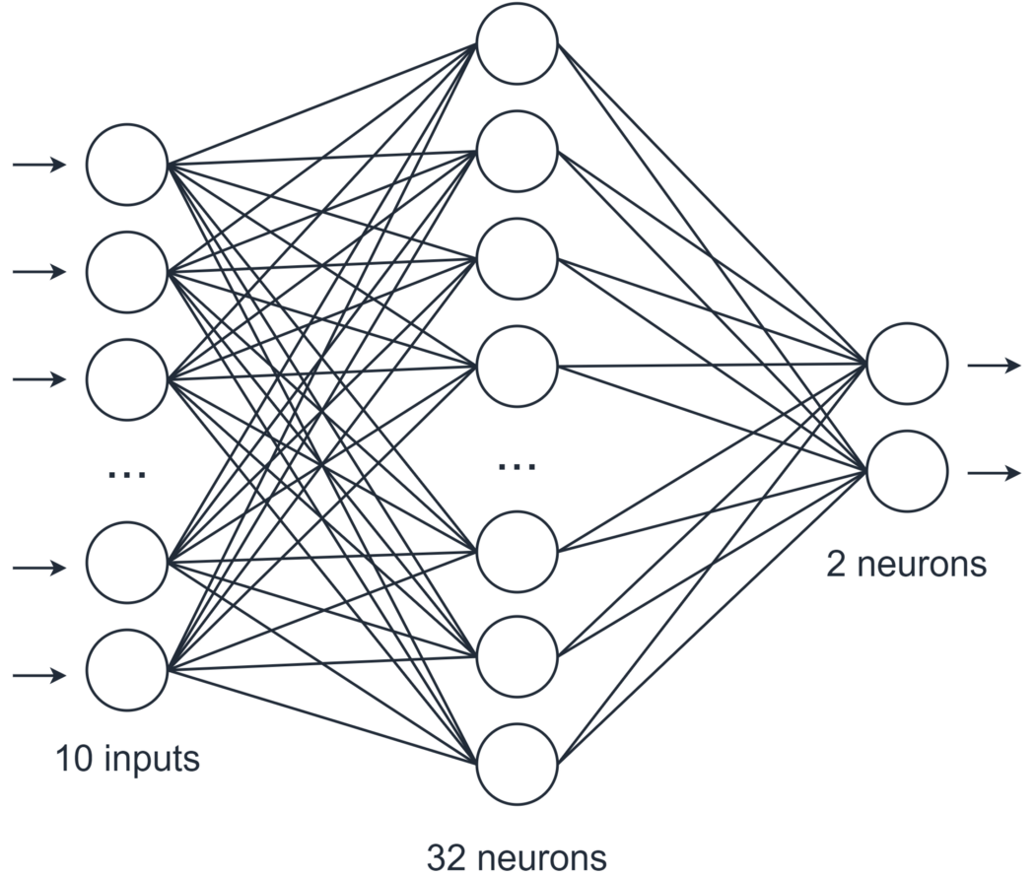
Using Keras to Develop a Neural Network
What is different, if Functional approach is used?
Let’s consider a multi-layer network
10 inputs
32 neurons in the hidden layer
2 neurons in the output layer

Slide 29
Using Keras to Develop a Neural Network
Using Sequential Approach
We can initialize a sequential model using tf.keras.Sequential.
From here, we have two options
Define the model at the same time
Add layers to the model as we go using the .add method
model = tf.keras.Sequential([ tf.keras.layers.Dense(32, input_shape=(10,), activation='relu'), tf.keras.layers.Dense(2, activation='softmax’)])
model = tf.keras.Sequential() model.add(tf.keras.layers.Dense(32, input_shape=(10,), activation='relu') model.add(tf.keras.layers.Dense(2, activation='softmax'))
Notes:
The batch dimension is automatically handled by Keras during training and inference, so there’s no need for a second argument.

Slide 30
Using Keras to Develop a Neural Network
Using Functional Approach
Rather than initializing a class as the starting block of the model, begin by defining the input(s) and layers. After this, set the input and output layers using the Model class, like so:
# define the input layer input_tensor = tf.keras.layers.Input(shape=(10,), dtype='int32’)
# setup network layers x = tf.keras.layers.Dense(32, activation='relu')(input_tensor) y = tf.keras.layers.Dense(2, activation='softmax')(x)
# create the model, specifying input and output tensors model = tf.keras.Model(inputs=input_tensor, outputs=y)

Slide 31
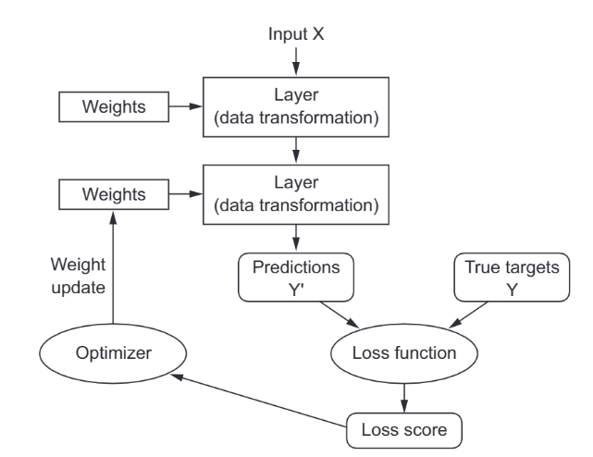
An illustration
Layers are chained together mapping the input to prediction
Predictions and true targets are compared to produce the loss value by the loss function
Optimizers use loss value to update the weights of the network

Slide 32
Example Walkthrough in Jupyter notebook
What is the difference between Regression and Classification?
What is the difference between binary and multi-class classification?

Slide 33
What is Data scaling?
Data scaling is the process of transforming the values of the features of a dataset till they are within a specific range, e.g., 0 to 1 or -1 to 1. This ensures that no single feature(variable) dominates the distance calculations in an algorithm and can help improve the algorithm’s performance.
Two Popular types of scaling
1- Standard Scaling
You need to import standardscalar from preprocessing package of sklearn library
from sklearn.preprocessing import StandardScaler
scaler = StandardScaler()
scaled_data = scaler.fit_transform(data)
2-Minmax scaling
MinMaxScaler scales all the data features in the range [0, 1] or else in the range [-1, 1] if the dataset has negative values.

Slide 34
Try with standardized data (PIMA Indian Diabetes Dataset)
In the same example for the prediction of diabetes, now you first scale the data and try to train the model and see of performance increases ?

Slide 35
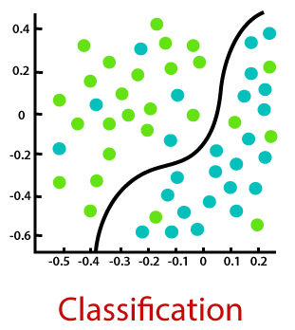

How to Evaluate a NN Model?

Slide 36
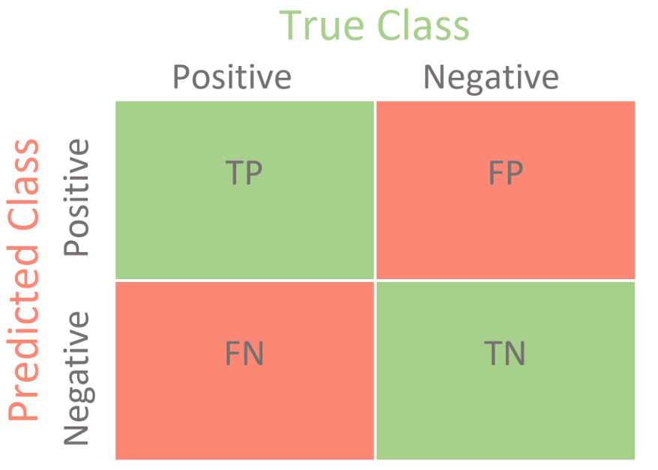
How to Evaluate a Classifier?
Examining Learning Curves
Ploting the accuracy and loss of the model across the entire epochs
Calculating Testing Accuracy
Testing the model with a new similar dataset and comparing the true and predicted output
Plotting Confusion Matrix
Generating Classification Report

Slide 37
How to Evaluate a Classifier?
What is a Confusion Matrix?
Case:Binary Classification
True Positive (TP): It refers to the number of predictions where the classifier correctly predicts the positive class as positive.
True Negative (TN): It refers to the number of predictions where the classifier correctly predicts the negative class as negative.
False Positive (FP): number of predictions where
the classifier incorrectly predicts the
negative class as positive.
False Negative (FN): It refers to the number of
predictions where the classifier incorrectly predicts
the positive class as negative.

Slide 38
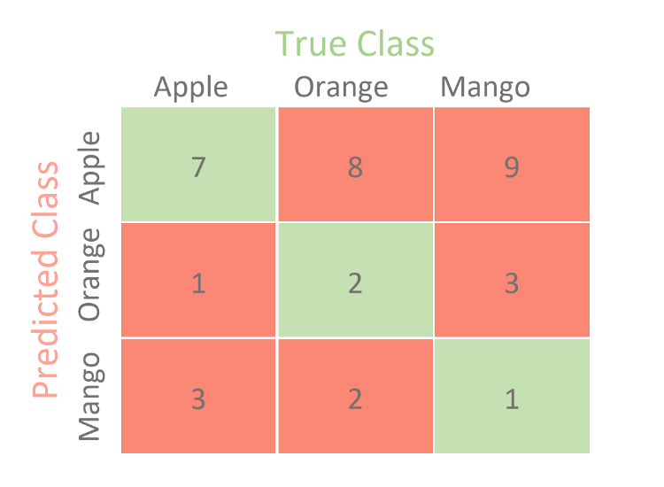
How to Evaluate a Classifier?
What is a Confusion Matrix?
Case:MultiClass Classification
Source: https://towardsdatascience.com/confusion-matrix-for-your-multi-class-machine-learning-model-ff9aa3bf7826

Slide 39
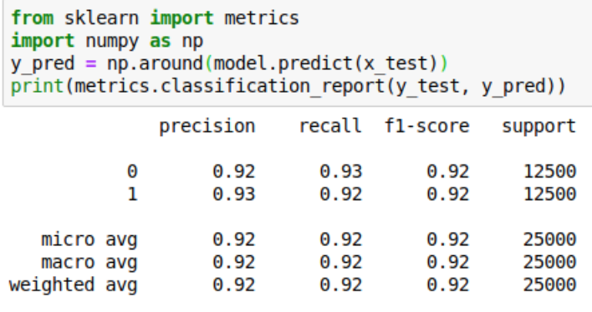
How to Evaluate a Classifier?
What is a Classification Report?

Slide 40
How to Evaluate a Classifier?
What is a classification Report?
Precision: represents the model’s ability to correctly predict the positives out of all the positive predictions it made
Precision Score = TP / (FP + TP)
Recall: model’s ability to correctly predict the positives out of actual positives.
(Recall score is a useful measure of success of prediction when the classes are very imbalanced)
Recall Score = TP / (FN + TP)
F1 Score: it is score as a function of precision and recall score. F-score is a machine learning model performance metric that gives equal weight to both the Precision and Recall for measuring its performance in terms of accuracy

Slide 41
How to Evaluate a NN Model?

Slide 42
Metrics to evaluate Regression Model
1. R Square/Adjusted R Square
how much variability in dependent variable can be explained by the model
2. Mean Square Error(MSE)/Root Mean Square Error(RMSE)
from sklearn.metrics import mean_squared_error
3. Mean Absolute Error(MAE)
from sklearn.metrics import mean_absolute_error

